Slide 1
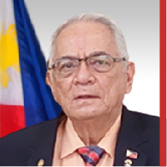
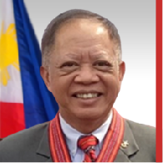
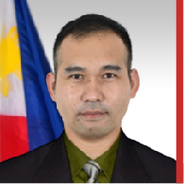
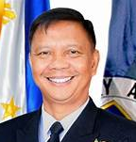
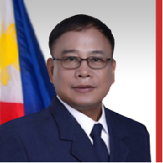
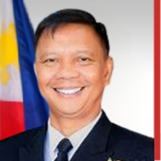
JOSE C. LAPUS
Trustee
• BS PMA 1965
• Cavalier Awardee, PMAAAI, 2017
• Commanding General, Visayas Command
• MBA, UP
• MPA, MLQU
• Board of Director, PHIVIDEC
• President, Mindanao Steel Corporation
RESTITUTO L. AGUILAR
Trustee
• BS PMA 1978
• Deputy Administrator, Philippine Veterans Affairs Office, 2022 to date
• Executive Director, National Historical Commission
of the Philippines, 2020-2021
• Editor-in-Chief, Cavalier Magazine, PMAAAI, 2002-2012
• Editor, Cavalier Handbook, 2012 & 2015 Editions
• Author, Academy Register, 2016
• Treasurer, PMA Foundation, Inc., 2020 to date
• Cavalier Award, PMAAAI, 2011
IRVIN S. HIBALER
Trustee
• BS PMA 2011
Chief, International Military Affairs Branch, Strategic and Special Studies Division, Office for Strategic Studies and Strategy Management
• MS Environmental Management,
• Student, PhD in Environmental Diplomacy and Negotiations
Military Assistant, Anti-Terrorism Council
• Program Management Center
• Philippine Institute of Environmental Planners
CAESAR BERNARD N. VALENCIA
Trustee, Ex Officio
• BS PMA 1990
• PMA Superintendent
Master in Management, University of New South Wales, Canberra, Australia
• Vice Commander, PN, 2022
• Chief of Naval Staff, 2021
• Commander of Naval Forces Northern Luzon, 2019
• Director of Naval Intelligence Training Institute
Dean of Academics for Naval Officer School Center

